Slide 1
Camunda
Orchestrate Anything, Automate Everything
Garth Knudson
Sr. Enterprise Account Executive
garth.knudson@camunda.com
T: 703.201.3201

Slide 2

About Camunda
Camunda enables process orchestration with a developer-friendly approach that is standards-based, highly flexible, and massively scalable.
6
190+
300+
Worldwide offices: America, Asia & Europe
Countries with people using Camunda
Employees
2008
Founded
100,000+
500+
Community Members
Enterprise Customers
Notes:
2

Slide 3
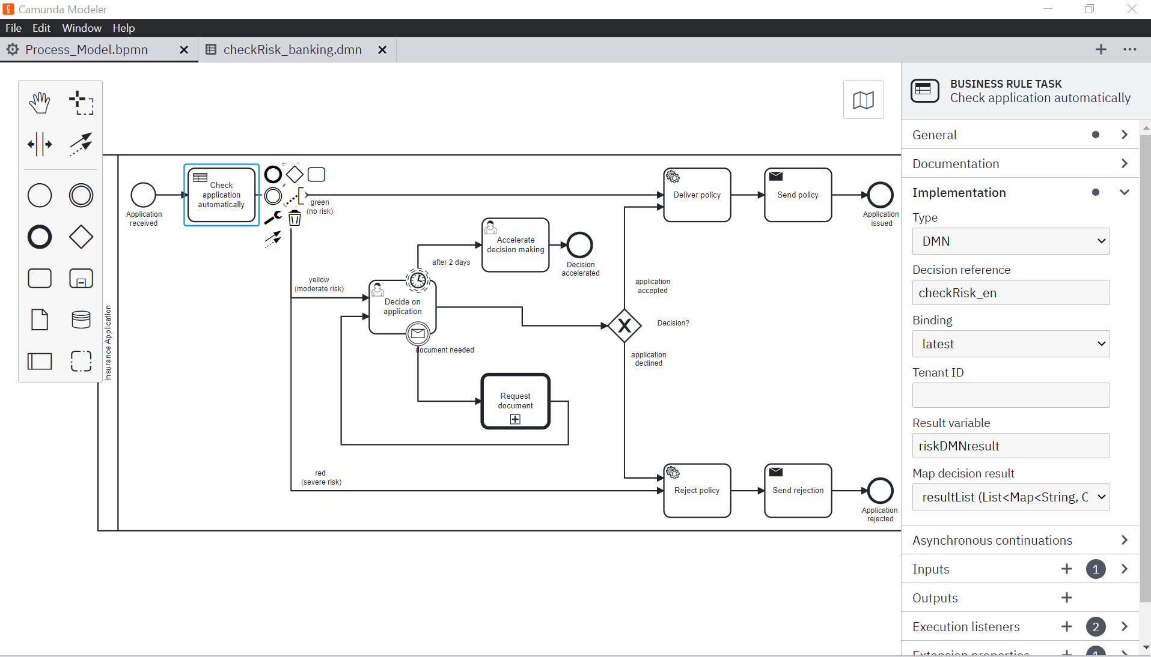
Market Positioning
Process Orchestration
Process Automation
+
Microservices Orchestration
Human Work
Business Rules
Microservices
AI
RPA
API
IoT

Slide 4
Market Positioning
Process Orchestration
Low Endpoint Diversity, Multiple Endpoints of the Same Type
Human Work
Business Rules
Microservices
AI
RPA
API
IoT
iPaaS
Notes:
[Jakob’s notes - please don’t change]
If process consists of REST API endpoints only, we might be able to run it via an API integration tool, like an iPaaS (typically used to move data from a to b, often low-code)
But end-to-end-processes are rarely limited to REST API endpoints only

Slide 5
Market Positioning
Process Orchestration
High Endpoint Diversity, Multiple Endpoints of the Multiple Types
Human Work
Business Rules
Microservices
AI
RPA
API
IoT
Process
Orchestration
Notes:
[Jakob’s notes - please don’t change]
True end-to-end-processes span horizontally
Might include some API endpoints, maybe also people, or RPA bots when our legacy system doesn’t offer an API
Process orchestration focuses on the challenge of dealing with high endpoint diversity

Slide 6


Market Positioning
Standards-Based
BPMN
DMN
Standards to more effectively collaborate across process design and rules management with built-in process execution, operational management, and continuous improvement

Slide 7
Market Positioning
Developer-Friendly
Standard-based process and decision modeling
Lightweight engine (Headless)
Open architecture
APIs & Connectors
Combined with preferred tools (e.g., Docker, OpenShift, Kubernetes, Kafka) and development frameworks without disrupting existing CI/CD

Slide 8
Market Positioning
Flexibly-Deployed
Loosely coupled components easily integrated with any technical architecture or framework
Invocation for components, services, activities, functions
Synchronous and Asynchronous sequences across all endpoints
Private cloud, public cloud, and on-premise deployments

Slide 9
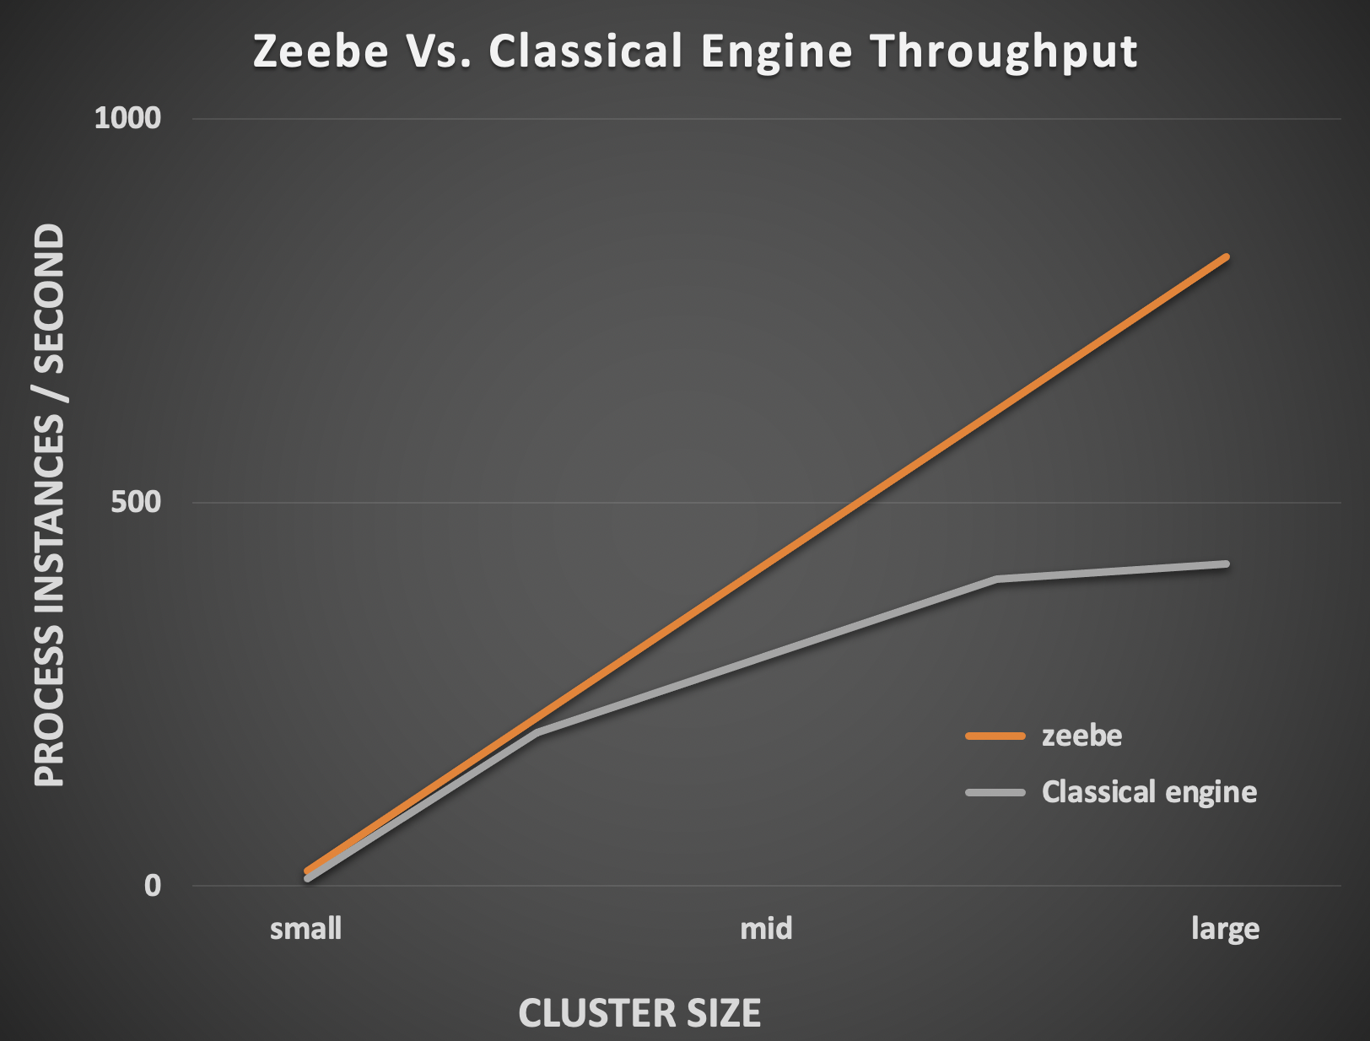
Market Positioning
Massively Scalable
Executes 100s transactions/second
Scale infinitely with Camunda 8

Slide 10
Platform Focus
Platform | Low-Code | Camunda
Target Persona | Business User (Requires heavy developer support to install, build, run, and maintain) | Architect / Developer (Do-it-Yourself engineers leveraging common skills and tools)
User Experience | Head (Build/Customize using OOTB UI/UX framework) | Headless (Build UI using Angular/React with OOTB APIs and Connectors; leverage OOTB forms and Tasklist for human workflow management)
Architecture | Proprietary (Heavy, infrastructure intensive) | Open (Open Source, Standards-Based, Loosely-Coupled, Lightweight, Cloud Native, Flexibly-Deployed)
Orchestration | Low Endpoint Diversity (Multiple Endpoints of the Same Type) | High Endpoint Diversity (Multiple Endpoints of the Multiple Types)

Slide 11
Market Landscape
Category | Vendors | Competitive? | Why Camunda
BPMS / Low-Code | IBM, Pega, Appian, Bizagi | Yes Camunda is an alternative | Camunda enables Developers to use their inherent skills (Java, Angular) combined with open standards (BPMN, DMN) and common tools (Docker, Kubernetes, Kafka, AWS) to quickly build headless apps orchestrating all types of endpoints (human, system, rules, APIs, microservices, RPA bots) at massive scale.
Microservices Orchestration | AWS Step Functions, Temporal.io, Orkes.io (Conductor), Infinitic.io (Pulsar) | Partially Camunda is more powerful | Camunda invokes components, services, activities, and functions in synchronous and asynchronous sequences across all types of endpoints while enabling Human Task Orchestration.
RPA | UiPath, Blueprism, Automation Anywhere | No Complementary | Camunda complements RPA by orchestrating RPA Bots along with all other endpoints (APIs, rules, AI/ML, humans) enabling complete control and visibility across end-to-end operations.
Process Mining | Celonis | No Complementary | Camunda consumes Process Mining artifacts to enable process automation across end-to-end operations.
Enterprise Integration | MuleSoft, Workato, Boomi | No Complementary | Camunda leverages Enterprise Integration tools to extend point-to-point application integration flows to enable end-to-end process orchestration with complete visibility and control.
Notes:
Though there isn’t much direct competition for Camunda, we often do replace more heavy-weight BPM Systems.
RPA, Process Mining and Enterprise Integration products are actually not competitive, but complementary. That means you can combine them with Camunda to complete your automation technology stack.

Slide 12
Camunda
Cost Effective (Open Source) | Organizations reduce costs (e.g., license, maintenance, infrastructure, development) while accelerating SDLC | Time to Value Business Agility Business Autonomy Innovation Flexibility
Standards-based (BPMN 2.0, DMN 1.3) | Stakeholders more easily learn, use, and collaborate across process design and execution with complete visibility into and control over operations
Developer-Friendly (Cloud-Ready) | Developers use their inherent skills (Java, Angular) and tools (Docker, Kubernetes, Kafka, AWS) to quickly build apps orchestrating all types of endpoints (human, system, rules, APIs, microservices, RPA bots) without disrupting existing CI/CD workflows
Flexibly-Deployed (End-to-End Orchestration) | Architects access loosely coupled components that invoke components, services, activities, and functions in synchronous and asynchronous sequences across all types of endpoints on-premise or in the cloud
Massively Scalable | Business Lines can grow their business to millions of transactions per day

Slide 13
 | Camunda Platform for Process Automation | Low-Code Platforms (Pega, Appian, IBM, etc.)
Best for | End-to-end process automation across disparate systems, end-points, and infrastructures | Rapid development of UI-centric applications
Business need | Drive digital transformation across end-to-end processes touching many data sources | Support line-of-business departments to build basic business applications
Key functionality | Process design, complex workflow and decision automation (incl. BPMN and DMN), process operations and analytics, integrations with most programming languages and technologies | Simple UI and form design; front-end business logic, user input-based data storage
App/UI design | Choose any UI framework/tool. Mix and max as needed. | Use build-in UI designer of low-code platform
Architecture | Open | Proprietary (vendor lock-in)
Typical user | Professional developers of all experience levels | Technical business users and less experienced developers
Developer learning curve and cost | Flat learning curve, standard resources broadly available. Any professional developer (Java, .Net etc.) can be productive right away. All documentation and community support is publicly available. | Despite the initial simplicity of low-code, users need proprietary training in each low-code platform. This is time consuming, and resources are often scarce and expensive (e.g. certified consultants).
User experience | User experience optimized for developers. Integral part of professional dev environment. Included “Smart low-code” features save developers work without limiting their flexibility. | Optimized point+click user experience inside the low-code platform. Limited to the capabilities of the platform.
Product strategy | Process automation that powers the digital enterprise. Open architecture, works across all types of technologies and infrastructures to design, automate and improve enterprise processes. | All-in-one “walled garden” - provide everything you need in one place to build basic applications typically on a department-level quickly.

Slide 14
Process Orchestration:
Camunda Platform for High Endpoint Diversity
State handling
Explicit processes
Message correlation & coordination
Compensation for problems
Timeout handling
Error handling
Transparency of status
Team collaboration
Notes:
An end-to-end, automated business process typically stretches across multiple individual microservices that must communicate and collaborate to achieve a business outcome, which is where a workflow engine like Zeebe comes in
A workflow engine manages the flow of a business process across microservices by visualizing, operating, and reporting on the process
These are some specific advantages of using a workflow engine to orchestrate microservices
State handling: A workflow engine can persist the state of each instance of a business process; for example, each order placed on an ecommerce website
Explicit processes: A workflow engine makes business processes explicit instead of burying them in code, which means processes are easier for teams to understand and modify
Message correlation and coordination: A workflow engine can merge messages that belong to a single process instance and decide on next steps
Compensation for problems: A workflow engine compensates if a business process encounters a problem that requires previously completed steps in the process to be undone
Timeout handling: A workflow engine tracks the passage of time and, if a message does not arrive on time, automatically takes action or switches to another path in the process flow
Error handling: A workflow engine allows you to specify the behavior that should happen when an error occurs; for example, retrying an action or taking another path in the process flow
Transparency of status: A workflow engine enables operations teams to monitor the status of process instances in real time
Team collaboration: A workflow engine that supports BPMN can provide graphical models of business processes that facilitate discussion between business stakeholders, developers, and operations teams

Slide 15
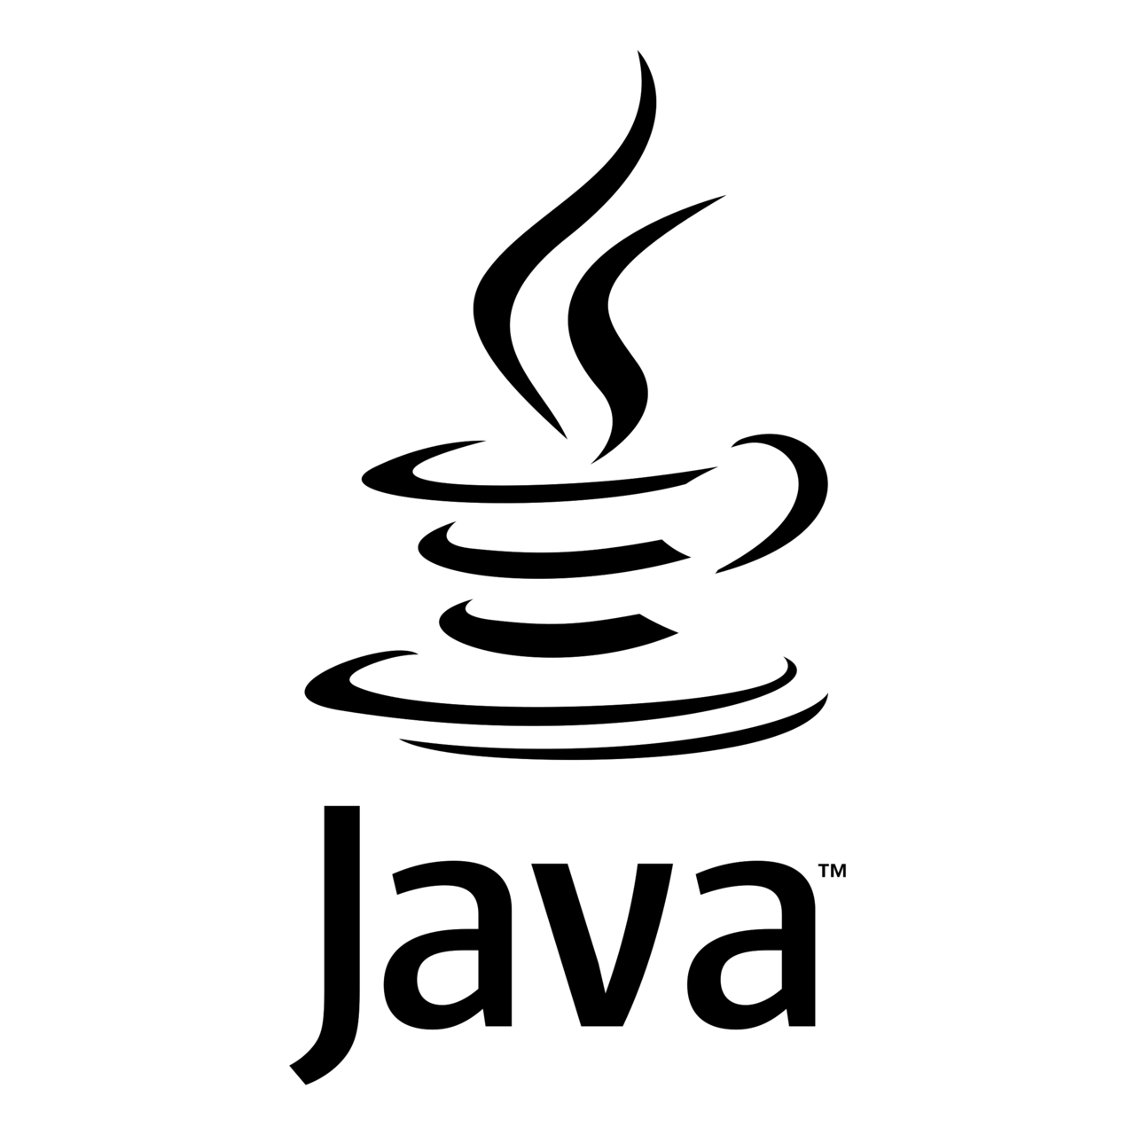







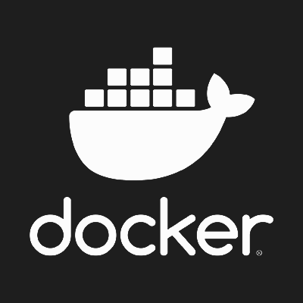
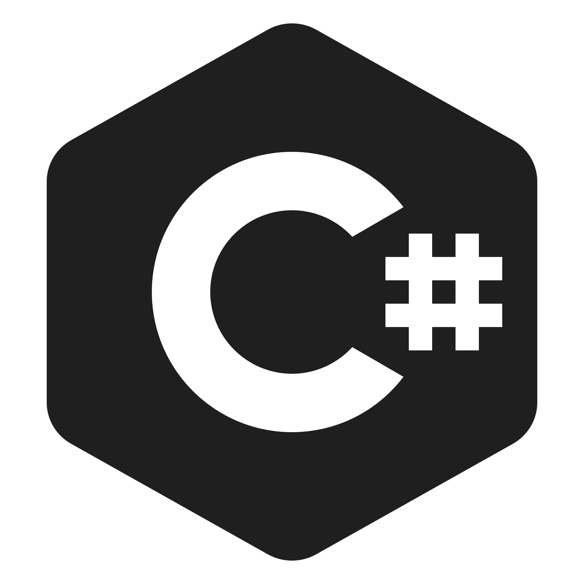


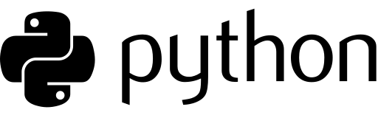


Code + deploy in your preferred language and tooling.
Run on your preferred platforms.
Across all endpoints.
Human Work
AI
Business Rules
Microservices
RPA
API
IoT
Systems (legacy + homegrown)
Notes:
We call our approach to process orchestration “universal” because we can orchestrate business processes, from start to finish, across a wide variety of endpoints
That includes everything from your legacy systems, to your next-generation microservices, plus your RPA bots, Internet of Things devices, and manual tasks
Because business processes are complex, we believe it’s critical to enable software developers and other IT users to deliver process automation projects by writing code in any programming language, working in their preferred IDE, using their existing CI/CD pipelines, and deploying to a variety of platforms – whether on premises or in the public, private, or hybrid cloud
Note: The icons on this slide represent the following technologies:
Java, Ruby, VSCode, IntelliJ, Azure DevOps, C#, Python, Eclipse, JUnit, Jenkins
Kubernetes, On Prem / Self-Managed, Cloud, Docker

Slide 16
Project Types and Skill Levels
Just code in Spring Boot!
Business Person
Citizen Developer
Consultant or
Power User
Bot Developer
Low-code Developer
Junior Developer or
Career Changer
Senior Developer
or
Camunda
Co-founder
Principal Developer
Complexity
Solution/project types:
Local automations or individuals automating parts of their job
No IT project
Smaller, probably department internal processes
IT project often hard to justify
Organizations automate their most critical core processes
Full IT projects, Continuous Delivery
Camunda’s Focus

Slide 17
Camunda Platform - Investment Priorities
Discovery
Design
Automation
Improvement
Process
Mining
Process Modeling
Process Orchestration
Business Intelligence
Event Bus
Frontend Technology
RPA
Low-Code Integration
Decision Automation
AI
Investment Focus
Continuous Investment
Partnerships
Notes:
[Jakob’s notes - please don’t change]
Different ways to look at this.
One way: hyperautomation tech stack we just discussed.
Focus our invest: Collaborative modeling (incl. Design for execution), Frontend tech to better support human task orchestration, and integration of different process endpoints in a low-code fashion. Will share more in a couple of minutes.
Continue to invest: Zeebe as orchestration engine and the operate toolset, DMN based decision automation, Optimize for real-time insights into process data
Will invest in technology partnerships for process discovery, microservices orchestration via event bus systems, combining process orchestration with RPA, and making orchestration smarter with AI technology.

Slide 18
Market Coverage
Sample Solution Use Cases
Access Management
Claims Processing​
Cloud Security Management​
Construction Job Management​
Customer Onboarding​
Customer Service
Drug Discovery
Eligibility and Enrollment
Fraud Management ​
Grants Management​
Housing Allocation​
Loan processing​
Order Processing
Order Servicing​
Payment processing​
Provisioning
Risk Management
Trade Execution
Underwriting
Wealth Management
USA Examples:
10 of the Top 15 Banks
3 of the Top 4 Telcos
2 of the Top 3 Fortune 500
Federal Government agencies ​
FinTech, InsureTech, HealthTech

Slide 19
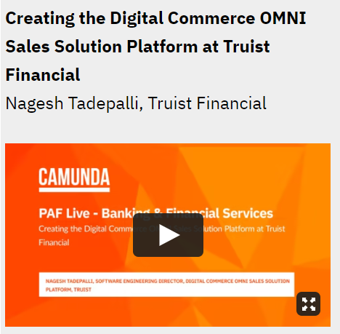
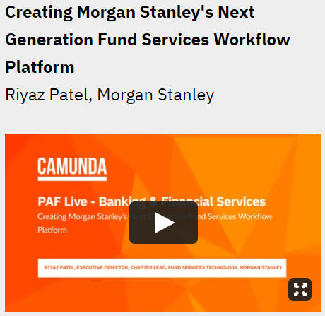
Market Coverage: Banking
Sample Solution Use Cases:
AML / KYC
Benefits and Disputes
Brokerage / Money Management
Collections
Corporate Audit and Credit Reviews
Data Quality
Digital Commerce
Fraud Management
Fund Services
Loan Origination
Payment Processing
Permit-to-Order/Permit-to-Build
Provisioning
Risk Management (Model Risk, Trade Mandate Risk, Credit Risk, Cross Risk)
Trade Execution (Validation, Booking, Enrichment, Settlement, Breach, Reconciliation)
Ticketing
https://page.camunda.com/wod-process-automation-forum-live-finance-banking-june2021-success

Slide 20
Common Camunda Uses
Top uses of Camunda across three areas of work
IT Initiatives
Technical Use Cases
Business Processes
Building a centralized process automation platform
Replacing a legacy business process management (BPM) suite
Replacing homegrown workflow technology
Moving applications to the cloud
Human workflow automation
Microservices orchestration
RPA bot orchestration
Decision automation
Document management
Customer onboarding and data management
Order management
Claims management
Loan origination
Risk management and underwriting
Notes:
We like to look at the usage of our software in three dimensions:
Cross-department IT initiatives like replacing legacy software or moving applications to the cloud
Technical problems that need to be solved, like how to orchestrate microservices or how to automate decisions
And core business processes that are often undergoing digital transformation, like customer on-boarding, insurance claim management, loan origination, etc.
Here you can see some examples, but we have customers that use Camunda software for many different types of initiatives and use cases

Slide 21
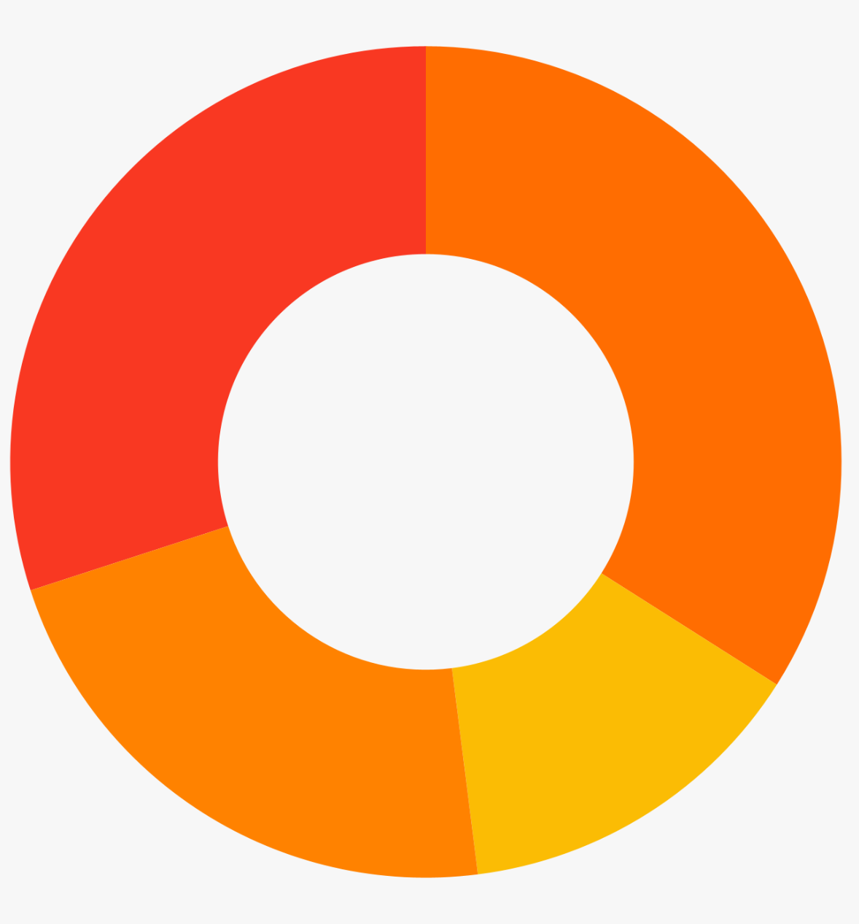
How Camunda
Changed the Game:
Solutions
Société Generale uses Camunda to power a central process automation platform for corporate investment banking, with 500+ modeled processes deployed worldwide.
IT Initiatives
Use Camunda as the engine to power modernization and centralization
Building a centralized process automation platform
30%
Moving to the cloud, modernizing applications, and other initiatives
34%
22%
14%
Replacing homegrown workflow technology
Replacing a legacy BPM suite
Survey of customer projects, n = 628
Notes:
We have many customers that have used Camunda as the foundation for a centralized process automation platform that different teams throughout the organization can use in their projects
We also see that many organizations are focusing on modernizing their applications and moving workloads to the public, private, or hybrid cloud
We also have customers that are focused on modernizing their business processes by replacing BPM products or homegrown technology that no longer meets their business needs

Slide 22
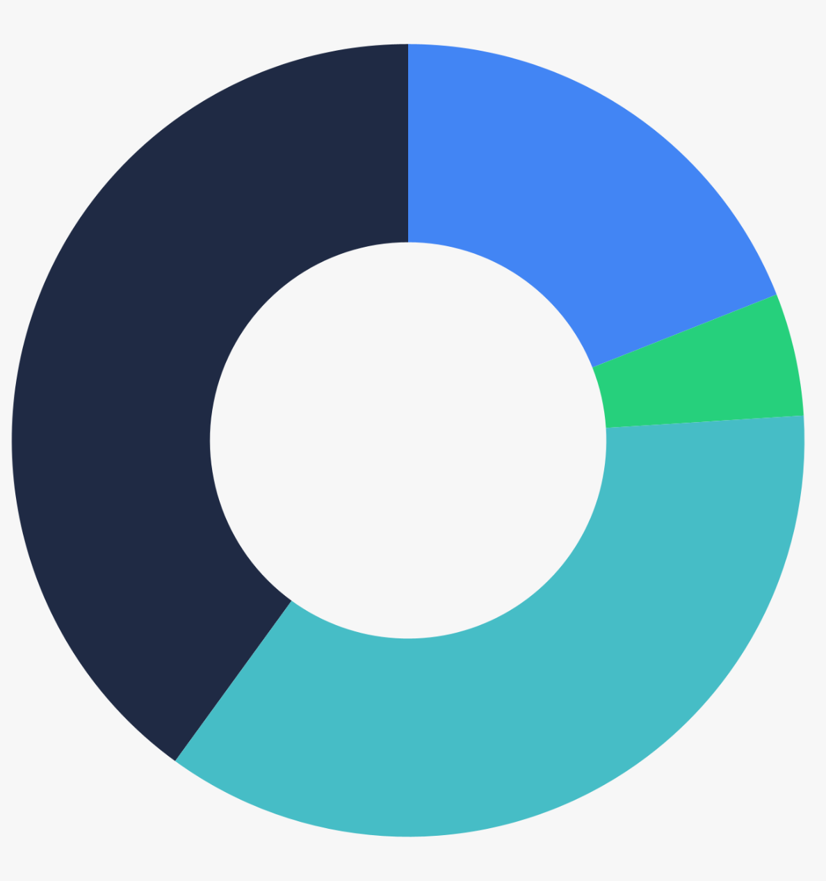
How Camunda
Changed the Game:
Solutions
Deutsche Telekom uses Camunda to orchestrate 3,000+ RPA bots in end-to-end processes that include APIs and other automated tasks.
Technical Use Cases
Orchestrate complex processes across diverse components and endpoints
Document management, scientific data processing, and other use cases
Service orchestration (including orchestration of microservices and RPA bots)
19%
40%
5%
Decision automation
Human task orchestration
36%
Survey of customer projects, n = 656
Notes:
Many of our customers have specific technical use cases that they’re working to achieve
Orchestrating human work is very common, and an area where we have a lot of experience helping companies get away from paper-based processes and leveraging automation where it makes sense
We also have many customers that are working to orchestrate microservices, RPA bots, and other technical parts of their processes
And there are plenty of companies that have projects focused on decision automation and other technical use cases that are specific to their business and their industry

Slide 23
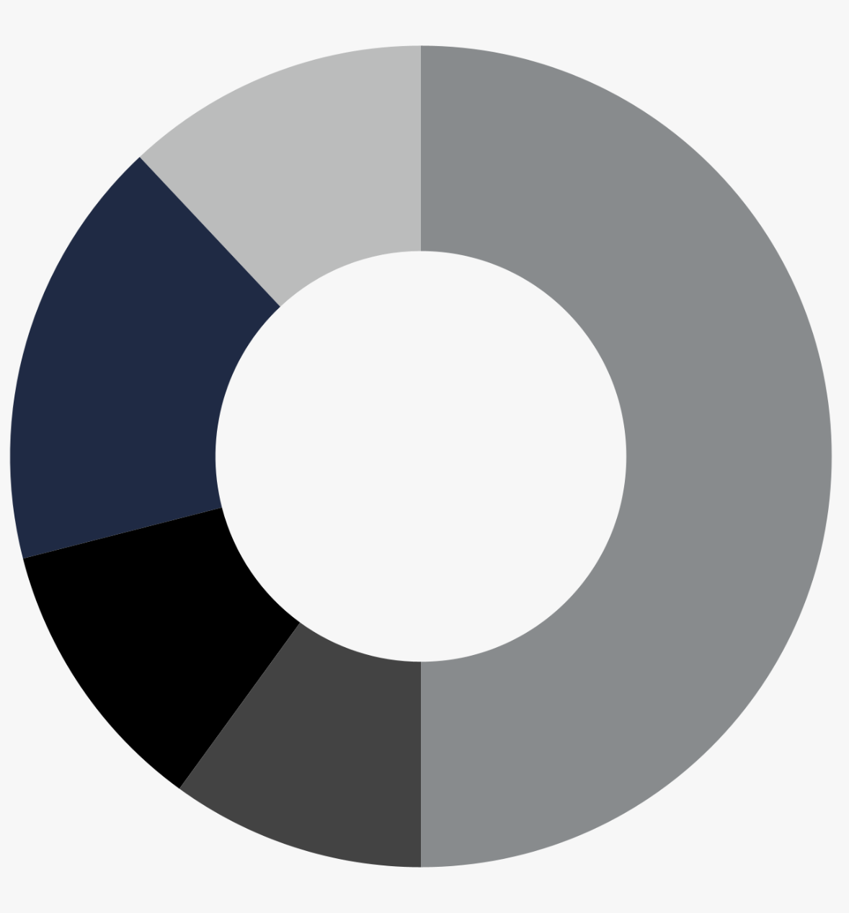
How Camunda
Changed the Game:
Solutions
Zalando, Europe’s largest online fashion retailer, uses Camunda to manage orders for over 16 million active customers in 15 markets.
Business Processes
Across industries and functional groups, Camunda makes work happen
Order management
Compliance data collection, medical records management,
and other processes
12%
50%
Customer onboarding and data management
17%
Loan origination
11%
10%
Claims management, risk management, and underwriting
Survey of customer projects, n = 675
Notes:
Looking at our customers’ specific business processes, we see a few common trends around customer onboarding, management of customer data, order management, loan origination, and insurance processes such as claims management
We also have many customers that are using Camunda products to collect compliance data, safely handle sensitive data such as medical records, and many other processes, both back-office processes and customer-facing processes

Slide 24
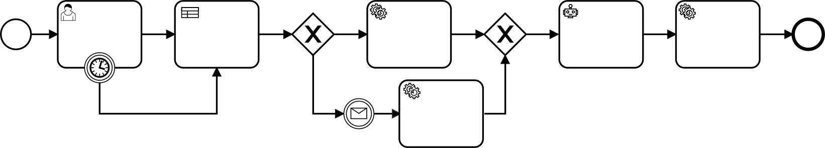







Camunda Platform: The Universal Process Orchestrator
Orchestrate
Automate
Transform
Complex process flows across people, systems and devices.
Any process, anywhere.
Your organization toward a digital future.
Collaborative Design and Develop
Flexibly Deploy & Run
Across All Endpoints
Human Work
AI
Business Rules
Micro Services
RPA
API
IoT
Systems (legacy + homegrown)
Notes:
Our vision is to be a universal process orchestrator for complex business processes that span people, systems, and devices
We give you the power to automate any process, anywhere, so you can transform your organization toward a digital future: where you’re delivering better customer experiences, with short time-to-value, more business agility than ever, and increased operational efficiency
We can help get you there by…
[CLICK] Using open standards to help IT teams and business stakeholders collaborate
[CLICK] Giving software developers the flexibility to use their preferred programming languages, tools, and practices
[CLICK] And providing connectors that orchestrate processes across endpoints
… and doing it all at scale to support your growing business

Slide 25
Camunda Platform 8
Zeebe, our cloud native workflow engine
New process experience components
New Connectors & Integration Framework
Collaboration via Modeler
Streamlined UI of Console & Operate
Flexibility
You host via Kubernetes or
We host on our cloud, instant setup & no infrastructure required
Open architecture & active developer ecosystem
Notes:
Zeebe, has the advantages we just ran through that unlock the vision of universal process orchestration
New process experience components
Out of the box connectors along with a new integration framework that allows you to build your own.
A new, full featured web modeler experience complete with collaboration features
Streamlined UI of Operate & Console that focus on the task at hand, helping you find what you need quickly
We’ll talk about these more in a moment
Additionally, you can host in your own environment in a DevOps & Kubernetes friendly way or be up and running in just minutes using our infrastructure and SaaS offering.
Lastly, the virtues of open architecture and community you know and love, continue on with Camunda Platform 8.
[refers to new integration frameworks, fostering community contributions and continuing our source available approach]

Slide 26
Camunda Platform 7 vs 8
Existing Component
New Component
 |  | Camunda 7 | Camunda 8
Design | Single User (Desktop) Modeling and IDE | Desktop Modeler |  | Desktop Modeler
 | Multi User (Web) Modeling | Cawemo |  | Web Modeler
 | Multi User (Web) Modeling and IDE | -
Automate | Workflow Execution | C7 BPMN Engine |  | C8 BPMN Engine (“Zeebe”)
 | System Integration | - |  | Connectors & Integration Framework
 | Decision Execution | DMN Engine |  | DMN Engine*
 | Human Task Management | Tasklist |  | Tasklist*
 | Technical Operations | Cockpit |  | Operate
Improve | Analytics and Reporting | Optimize |  | Optimize
* architecture differences, feature parity (latest version https://docs.camunda.io/docs/guides/)
Notes:
This slide shows what is new in Camunda 8 compared to Camunda 7.
Checkmark = We’ve talked through this
Magnifying glass = We’re about to deep dive on these
WALK THROUGH THE SLIDE.
We’ve already talked about Zeebe, next we’ll show you what’s new with Web Modeler, Connectors & our new integration framework, and lastly Operate (Camunda 8’s streamlined equivalent on C7’s Cockpit)

Slide 27
Available as SaaS or Self-Managed
 |  | Camunda 7 | Camunda 8
Self-Managed | Free Version | “Community” - Limited Features (Apache License) | “Free” - All Features* (Zeebe Community License**)
 | Commercial Version | “Enterprise” | “Enterprise”
SaaS | Free Version | - | “Free Trial”
 | Commercial Version | - | “Professional” / “Enterprise”
(*) For Camunda 8, all features are available in the free version, but production usage is only allowed for Zeebe and Modeler.
(**) Zeebe Community License is a source-available license, i.e. the source code is openly available (on GitHub) and you can use the technology for free (Only Exception: you’re not allowed to use it to provide a Commercial Process Automation Service.)
Notes:
Camunda 8 will continue to offer a free version via our Self-Managed edition - this allows unlimited usage of all features for non-production usage. Free Edition production usage is allowed for Zeebe and Modeler.
The licensing for the workflow engine has changed to source available. Our commitment to open-source values remains unchanged. The exception that causes the shift to "source-available" is explicitly designed to protect Camunda from the creation of a competitive managed service offering by cloud infrastructure providers using the Zeebe codebase. All other aspects of open-source licensing remain in place and ensure that our community continues to have access to use and modify the codebase via GitHub. Additionally, we encourage our community to continue building extensions and joining the active conversation on our community forums. Licensing for Camunda Platform 7.xx will remain unchanged - on the existing Apache 2.0 license. This is becoming increasingly common in the industry with the likes of Elastic and MongoDB

Slide 28

Camunda Platform: The Universal Process Orchestrator
Design
Automate
Improve
Developers & business users collaborate to design, connect & deploy processes with Camunda.
Enterprise-grade automation platform. Built for today’s business complexity, loved by developers.
Teams have the insights to fix the highest ROI problems for their business processes.
Modeler
Model & deploy business process diagrams with BPMN & DMN.
Available via web and desktop app.
Zeebe
Next-generation, cloud-native workflow engine that unlocks unparalleled speed, scale & resilience. Open source SDKs in your preferred programming language brings the extensibility you need for your complex business processes.
Optimize
Get the insights you need to understand and continuously improve your business processes.
Tasklist
Assign and execute tasks that require human interaction via easy-to-use Forms or via your own apps with the Tasklist API.
Connectors
Integration Framework
Forms
Operate
Real time visibility to monitor, analyze and resolve problems with any process instance.
Out-of-the-box integrations to easily communicate with popular enterprise applications & protocols.
Build & provision your own connectors to any system including homegrown & legacy applications.
Drag & drop creation of forms that power workflows that require human interaction.
Notes:
We think about process orchestration in terms of a lifecycle that supports continuous improvement
[CLICK] Starting with tools that help software developers and business users collaborate to design processes
Teams use our Modeler tool to build processes using the BPMN standard and implement decision automation using the DMN standard
Modeler is also where you’ll find out-of-the-box connectors, and where you can create your own reusable connectors
And you can use Modeler to quickly build user task forms for workflows that require human interaction
[CLICK] Once teams have collaboratively designed processes, you can start automating them in a high-performance way
Our next-generation workflow engine, Zeebe, is designed for speed, scale, and resilience; which means your processes will be both fast and reliable
We also offer an application called Tasklist, for tasks that require human interaction, which is essential for business processes that can’t be or shouldn’t be fully automated
And we provide a powerful process manager called Operate, which provides real-time visibility into running processes and tools to troubleshoot incidents
[CLICK] Finally, once you have processes running, Optimize uses your actual process data to provide comprehensive analytics…
[CLICK] … that guide you toward continuous improvement of your process’ performance

Slide 29
Zeebe
Next-generation, cloud-native workflow engine that unlocks unparalleled speed, scale & resilience. Open source SDKs in your preferred programming language brings the extensibility you need for your complex business processes.
Enterprise-grade automation platform. Built for today’s business complexity, loved by developers.
Tasklist
Assign and execute tasks that require human interaction via easy-to-use Forms or via your own apps with the Tasklist API.
Operate
Real time visibility to monitor, analyze and resolve problems with any process instance.
Optimize
Get the insights you need to understand and continuously improve your business processes.
Modeler
Model & deploy business process diagrams with BPMN & DMN.
Available via web and desktop app.
Notes:
We think about process orchestration in terms of a lifecycle that supports continuous improvement
[CLICK] Starting with tools that help software developers and business users collaborate to design processes
Teams use our Modeler tool to build processes using the BPMN standard and implement decision automation using the DMN standard
Modeler is also where you’ll find out-of-the-box connectors, and where you can create your own reusable connectors
And you can use Modeler to quickly build user task forms for workflows that require human interaction
[CLICK] Once teams have collaboratively designed processes, you can start automating them in a high-performance way
Our next-generation workflow engine, Zeebe, is designed for speed, scale, and resilience; which means your processes will be both fast and reliable
We also offer an application called Tasklist, for tasks that require human interaction, which is essential for business processes that can’t be or shouldn’t be fully automated
And we provide a powerful process manager called Operate, which provides real-time visibility into running processes and tools to troubleshoot incidents
[CLICK] Finally, once you have processes running, Optimize uses your actual process data to provide comprehensive analytics…
[CLICK] … that guide you toward continuous improvement of your process’ performance

Slide 30
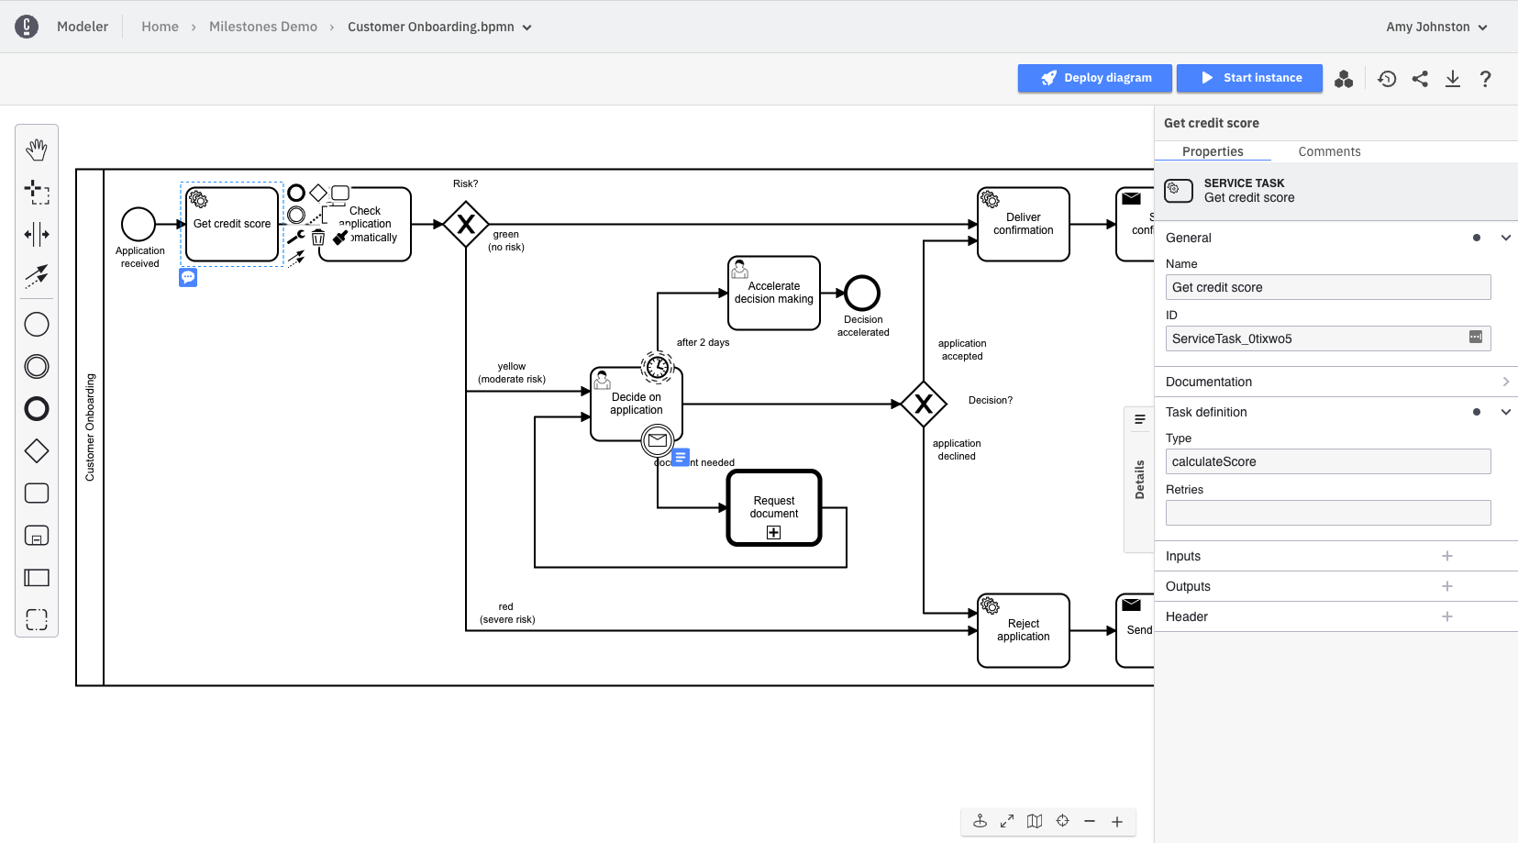
Camunda Platform: The Universal Process Orchestrator
Design
Deploy and run BPMN models
Versioning and diffing of BPMN models
Developers & business users collaborate to design, connect & deploy processes with Camunda.
Modeler
Model & deploy business process diagrams with BPMN & DMN.
Available via web and desktop app.
Share and collaborate on BPMN models
Leave comments for collaboration
Improved properties panel
Connectors
Integration Framework
Forms
Out-of-the-box integrations to easily communicate with popular enterprise applications & protocols.
Build & provision your own connectors to any system including homegrown & legacy applications.
Drag & drop creation of forms that power workflows that require human interaction.
Notes:
At Camunda, we think about process orchestration in terms of a lifecycle, starting with tools that help software developers and business users collaborate to design processes
Teams use our Modeler tool to build processes and user task forms
[CLICK] In Camunda Platform 8, you can use a web-based Modeler or the Desktop Modeler that you might know from Camunda 7
We’ve added many new features, including support for comments, versioning, and sharing
We also redesigned the properties panel and added support for deploying and running processes directly from the Modeler web interface

Slide 31





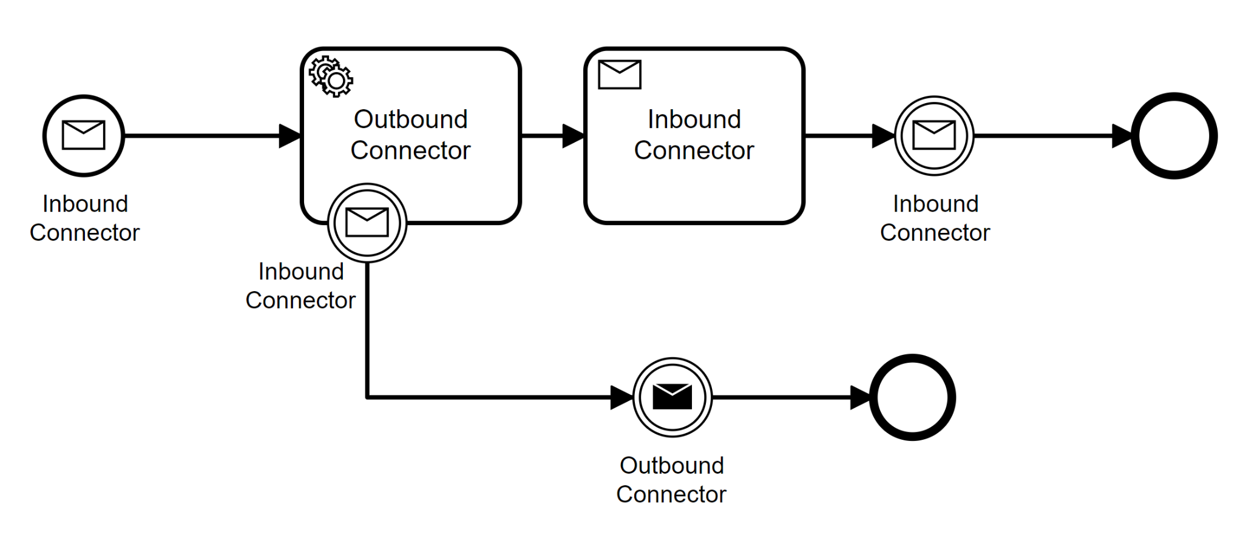
Camunda Platform: The Universal Process Orchestrator
Design
Developers & business users collaborate to design, connect & deploy processes with Camunda.
An outbound connector lets the process invoke an outside system to do something
An inbound connector means the process can be triggered by an outside system
Discover and reuse connectors, out of the box or built via the new Integration Framework
Modeler
Model & deploy business process diagrams with BPMN & DMN.
Available via web and desktop app.
Connectors
Integration Framework
Forms
Out-of-the-box integrations to easily communicate with popular enterprise applications & protocols.
Build & provision your own connectors to any system including homegrown & legacy applications.
Drag & drop creation of forms that power workflows that require human interaction.
Notes:
We’re also adding powerful new ways to connect Camunda Platform to other tools and systems in your technology stack
Out-of-the-box connectors help you communicate with any tool or system, reducing the time it takes to orchestrate business processes
Users access connectors via a catalog and insert them into BPMN diagrams in the Modeler interface
A new Integration Framework lets you build your own connectors and add them to Modeler, so any process can reuse them
Custom connectors are perfect for organizations that have legacy or homegrown systems
Connectors are a reliable automation alternative to brittle, maintenance-heavy RPA bots
Bi-directional connectivity allows you to invoke an outside system, or trigger a process when an event happens in an outside system

Slide 32
Connector Examples
Camunda Platform: The Universal Process Orchestrator
Design
Developers & business users collaborate to design, connect & deploy processes with Camunda.
Cloud Connectors such as Kafka/SQS/Camel message queues, AWS Lambda functions, or Eventbridge; conforming to REST, GraphQL, or SOAP protocols
Service Connectors such as RPA, AI or IoT services
Business Connectors such as Salesforce or proprietary internal applications
Productivity Applications Connectors such as Slack for notifications
Enterprise Content Connectors such as Box or OpenText
Data Connectors such as BI systems, data lakes, or data warehouses
Modeler
Model & deploy business process diagrams with BPMN & DMN.
Available via web and desktop app.
Connectors
Integration Framework
Forms
Out-of-the-box integrations to easily communicate with popular enterprise applications & protocols.
Build & provision your own connectors to any system including homegrown & legacy applications.
Drag & drop creation of forms that power workflows that require human interaction.
Notes:
Connectors launched in Camunda Platform 8.0 as a developer preview
We are building many different types of connectors, including:
Cloud connectors that communicate with cloud-native applications
Service connectors that integrate with technology enablers such as RPA
Business connectors that connect to CRM or ERP applications, industry-specific applications, and proprietary internal applications
Productivity connectors that leverage email or Slack
Enterprise content connectors that push content to or pull content from tools such as Box
Data connectors that push content to or pull content from data providers to make conditional decisions in processes

Slide 33
Camunda Platform: The Universal Process Orchestrator
Automate
Enterprise-grade automation platform. Built for today’s business complexity, loved by developers.
Camunda 8’s Next-Generation Workflow Engine
POWERED BY ZEEBE
Workflow Engine
Next-generation, cloud-native BPMN workflow engine that unlocks unparalleled speed, scale & resilience.
~ 880 PI/s
Decision Engine
Automate decisions in end-to-end business processes via DMN.
~ 1010 PI/s
Process instances per second (throughput)
~ 530 PI/s
~ 380 PI/s
Cluster size
Tasklist
Assign and execute tasks that require human interaction via easy-to-use Forms or via your own apps with the Tasklist API.
6
9
15
Operate
Real time visibility to monitor, analyze and resolve problems with any process instance.
Notes:
Once you’ve designed your processes, you can start automating them in a high-performance way
[CLICK] Camunda 8 has a cloud-native workflow engine called Zeebe, which is a cloud-native tool that enables true horizontal scalability and resilience
You can scale throughput in a linear fashion by adding cluster nodes, which makes it possible to process an unlimited amount of transactions at consistent low latencies
Zeebe is ideal for the Camunda 7 use cases that you might be familiar with, as well as new use cases such as processing high volumes of orders, or processing financial transactions in real time
To ensure resilience, Zeebe comes with a failover architecture that supports geo-replication across data centers
For improved security, Zeebe’s architecture decouples the main core from external systems (through task workers)
Zeebe’s native support for the External Task Client Pattern is the foundation for connectors and the new integration framework

Slide 34
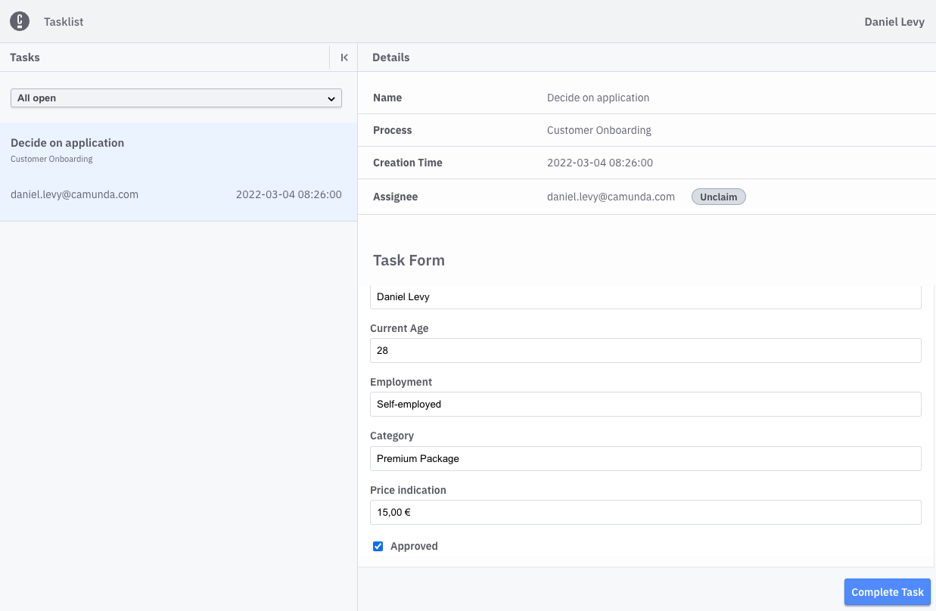
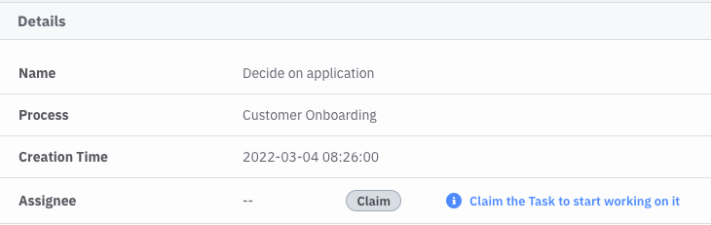
Camunda Platform: The Universal Process Orchestrator
Automate
Tasklist for human task orchestration
Enterprise-grade automation platform. Built for today’s business complexity, loved by developers.
Manual claim or automatically assign human tasks
Integrated UI via Forms or extend via GraphQL API
Critical for long running, real world business processes
POWERED BY ZEEBE
Workflow Engine
Next-generation, cloud-native BPMN workflow engine that unlocks unparalleled speed, scale & resilience.
Decision Engine
Automate decisions in end-to-end business processes via DMN.
Tasklist
Assign and execute tasks that require human interaction via easy-to-use Forms or via your own apps with the Tasklist API.
Operate
Real time visibility to monitor, analyze and resolve problems with any process instance.
Notes:
Camunda Platform 8 offers a web application for workflows that require human tasks
It serves the same purpose as the Tasklist component in Camunda Platform 7, but it has been redesigned for the cloud
You can use Tasklist as an out-of-the-box user interface, or integrate it with your custom user applications using the GraphQL API

Slide 35
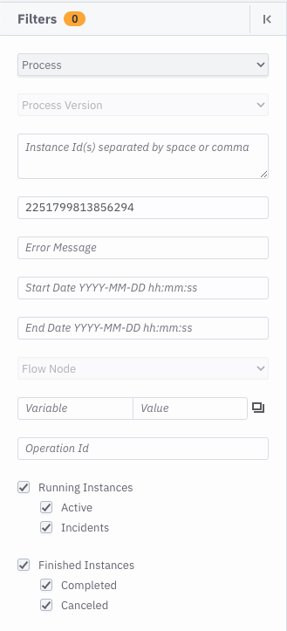
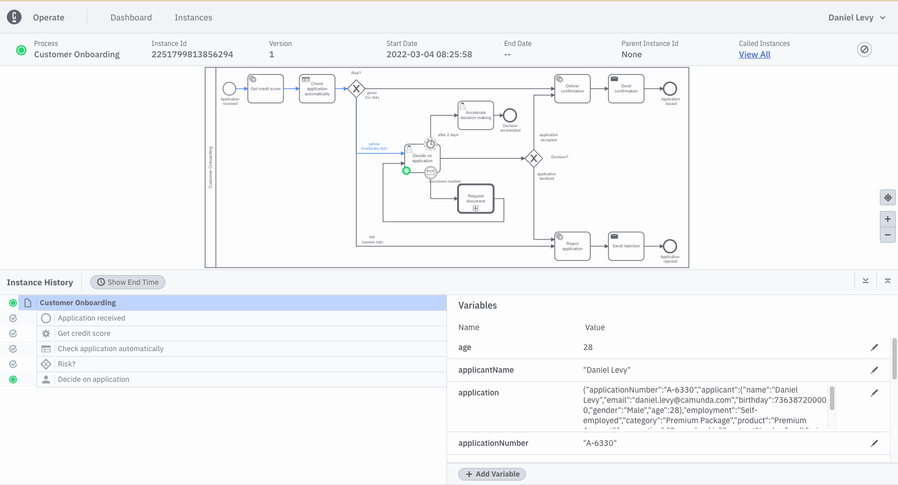
Camunda Platform: The Universal Process Orchestrator
Automate
Operate for visibility, insights and troubleshooting
Enterprise-grade automation platform. Built for today’s business complexity, loved by developers.
Dashboard UI designed for focus
Filter everything, together
Elasticsearch replaces relational DB
Improved navigation
Batch operations now easier
POWERED BY ZEEBE
Workflow Engine
Next-generation, cloud-native BPMN workflow engine that unlocks unparalleled speed, scale & resilience.
Decision Engine
Automate decisions in end-to-end business processes via DMN.
Tasklist
Assign and execute tasks that require human interaction via easy-to-use Forms or via your own apps with the Tasklist API.
Operate
Real time visibility to monitor, analyze and resolve problems with any process instance.
Notes:
Operate is a new component in Camunda Platform 8 that allows teams to monitor running processes, so they can troubleshoot them effectively
It can access both historical data and runtime data, and offers powerful filters for both types of data
Operate offers:
A dashboard that helps you focus on incidents and breakdowns
Easy navigation through BPMN Call Activities
Convenient batch operations so you can manage many process instances at the same time

Slide 36
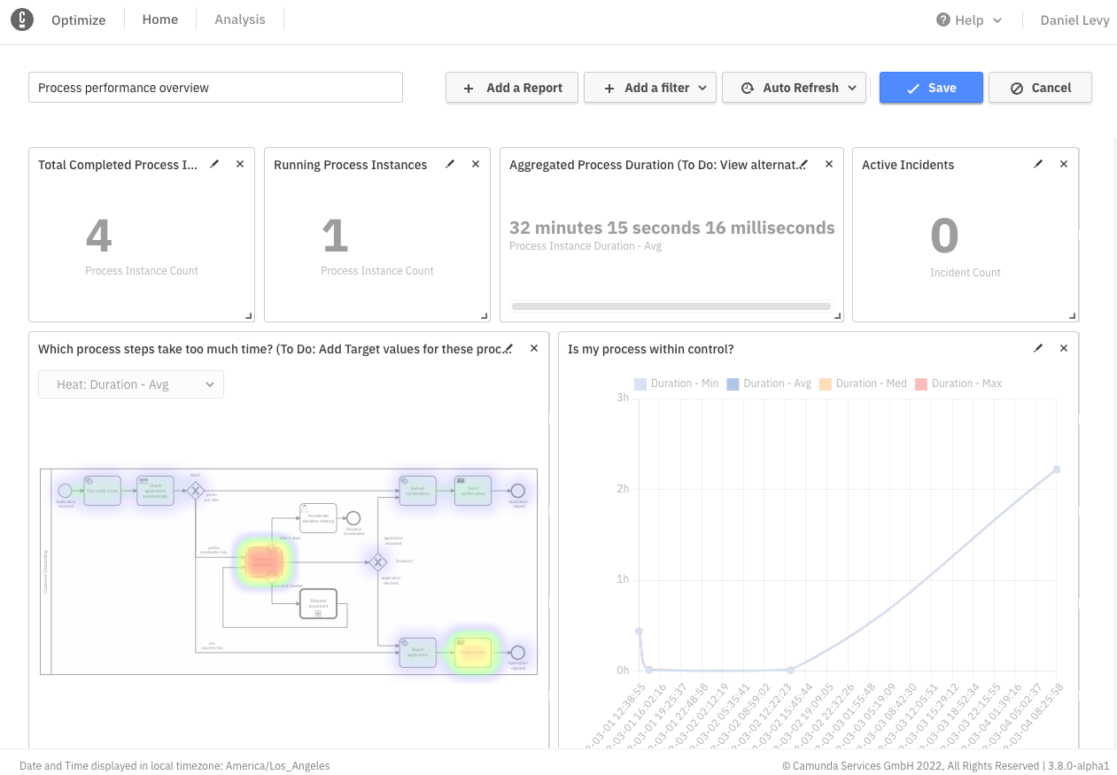
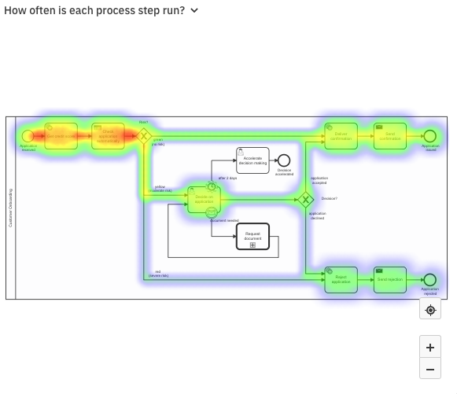
Camunda Platform: The Universal Process Orchestrator
Improve
Optimize for BPMN-based analysis & insights
Teams have the insights to fix the highest ROI problems for their business processes.
Process visualization & insights
Performance monitoring & alerting
Sharable dashboards
Optimize
Get the insights you need to understand and continuously improve your business processes.
Notes:
We think about process orchestration in terms of a lifecycle that supports continuous improvement, and comprehensive process data is important for that lifecycle
[CLICK] Optimize gives you the insights you need to understand and continuously improve your business processes
It provides performance monitoring, alerts for the KPIs that are important for your team and your business, and dashboards that you can share across the organization

Slide 37
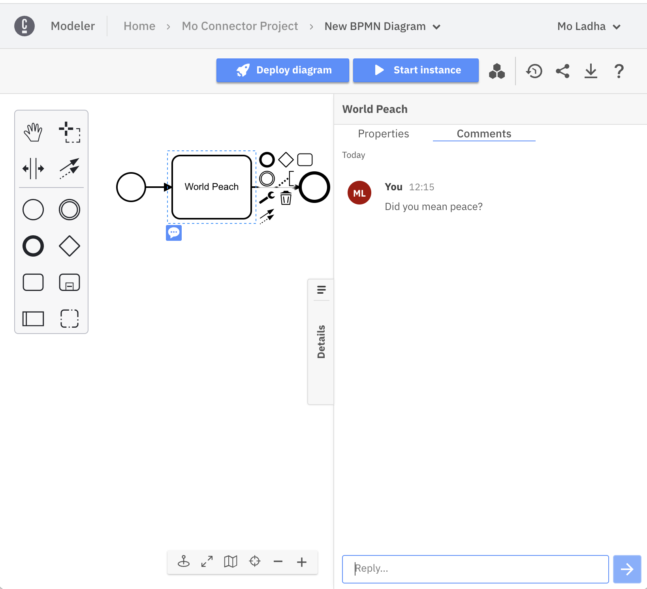
Enable Business and IT Collaboration
Developers and Designers iterate with agility on business problems
Team Projects
Store all your project contents in a single place, and collaborate with users granting permissions to edit, view and comment on process, forms and files
Review Milestones
Stakeholders in the business need to review progress. Set a milestone and rollback as needed
Share Process
Easily share your diagrams with anyone inside or outside your team
Comment on change
Interact with project members with comments on specific elements

Slide 38
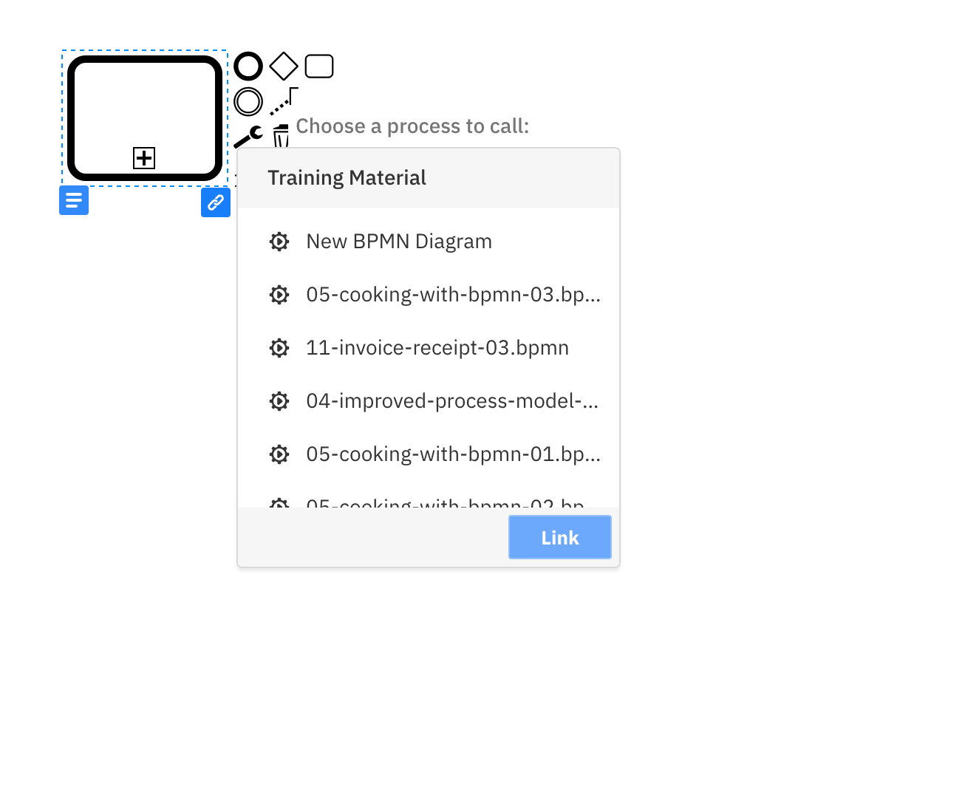
Link Assets to Your Processes
Find and link project assets together
Map Business Rules
Link DMN tables to your business rules with Camundas simple and intuitive interface
Mapping Processes together
Easily find and link process together in the web modeler, making it simpler to orchestrate complex business problems

Slide 39
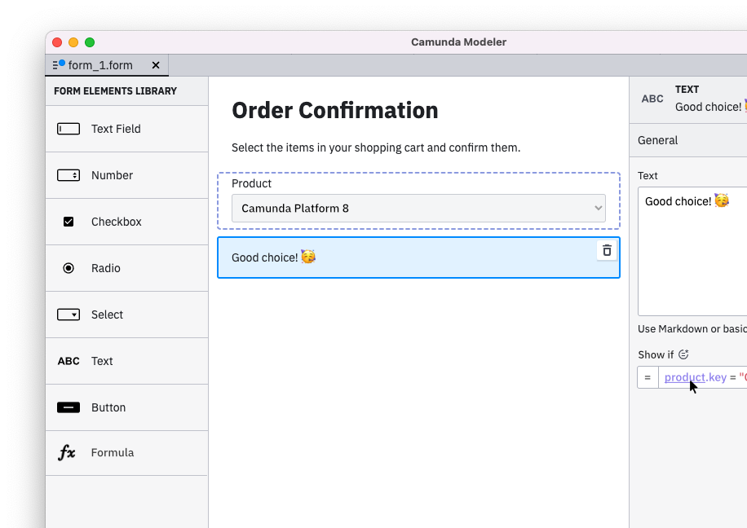
Create Flexible Forms and UX
Build and ship fast
Extended Component Portfolio
Implement human workflow use cases effortlessly with new ready-to-go components.
Field Data Population
Adopt to dynamic use cases by providing select values via process variables.
Preview & Validation
Validate that your forms work as you intended instantly by powering a preview with mock data.

Slide 40
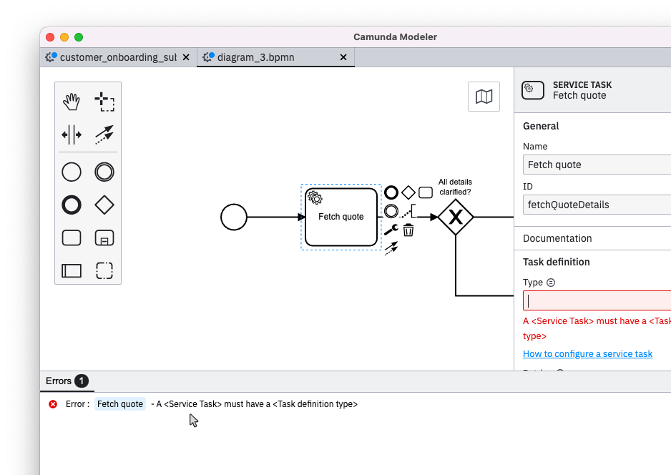
Enable End-to-End Debugging
Validate your models prior to debugging with guidance on errors and warnings
Proactive Debugging UX
Identify and react to problems before they can occur in operations.
Helpful Warnings
Helpful warnings and tips help you draw + implement better models faster.
!

Slide 41
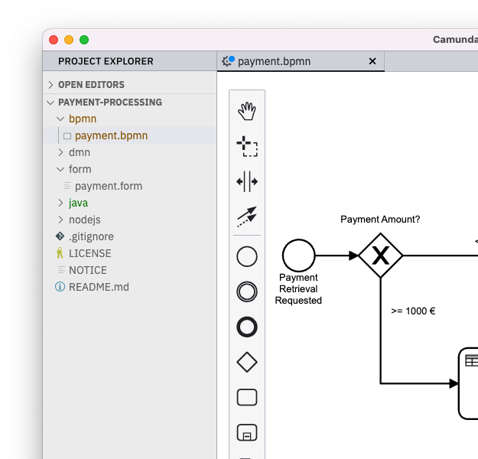
Create Multi-File Projects
Speed up your development workflow by using a project scope
Multi-File Support
Manage your automation projects locally and remotely as you manage your code projects.
Or stick to single files for on-the-fly modeling and adjustments.
*
Deployment-Target Management
Set and persist deployment targets project-wise to accelerate workflows and to make context-switching easy.
*Image for demonstrative purposes only - not actual in-app footage

Slide 42
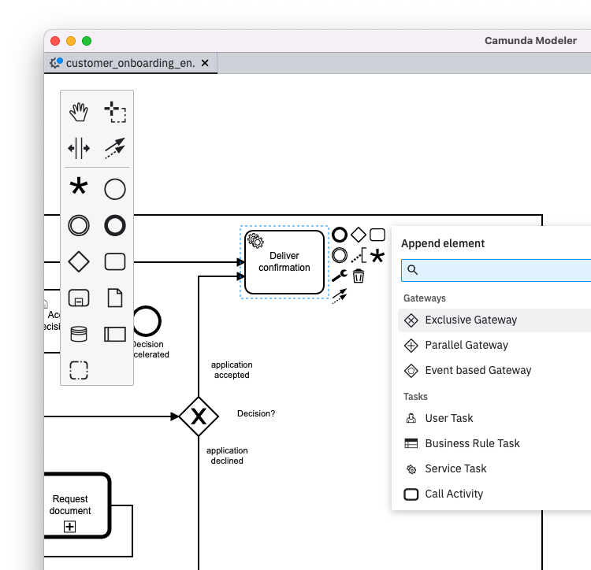


Enable Modeling + Refactoring Actions
Intuitive modeling features to let you get things done faster and hassle-free
Append Anything
Append anything anywhere with this powerful new control. No need to browse through items manually - and it really saves you clicks.
Multi-Select Context Pad
Apply alignment and other group-related operations easily with the new context pad for multi-element selections.
The pad will be the place for new batch operations and one-click refactoring actions in the future.

Slide 43
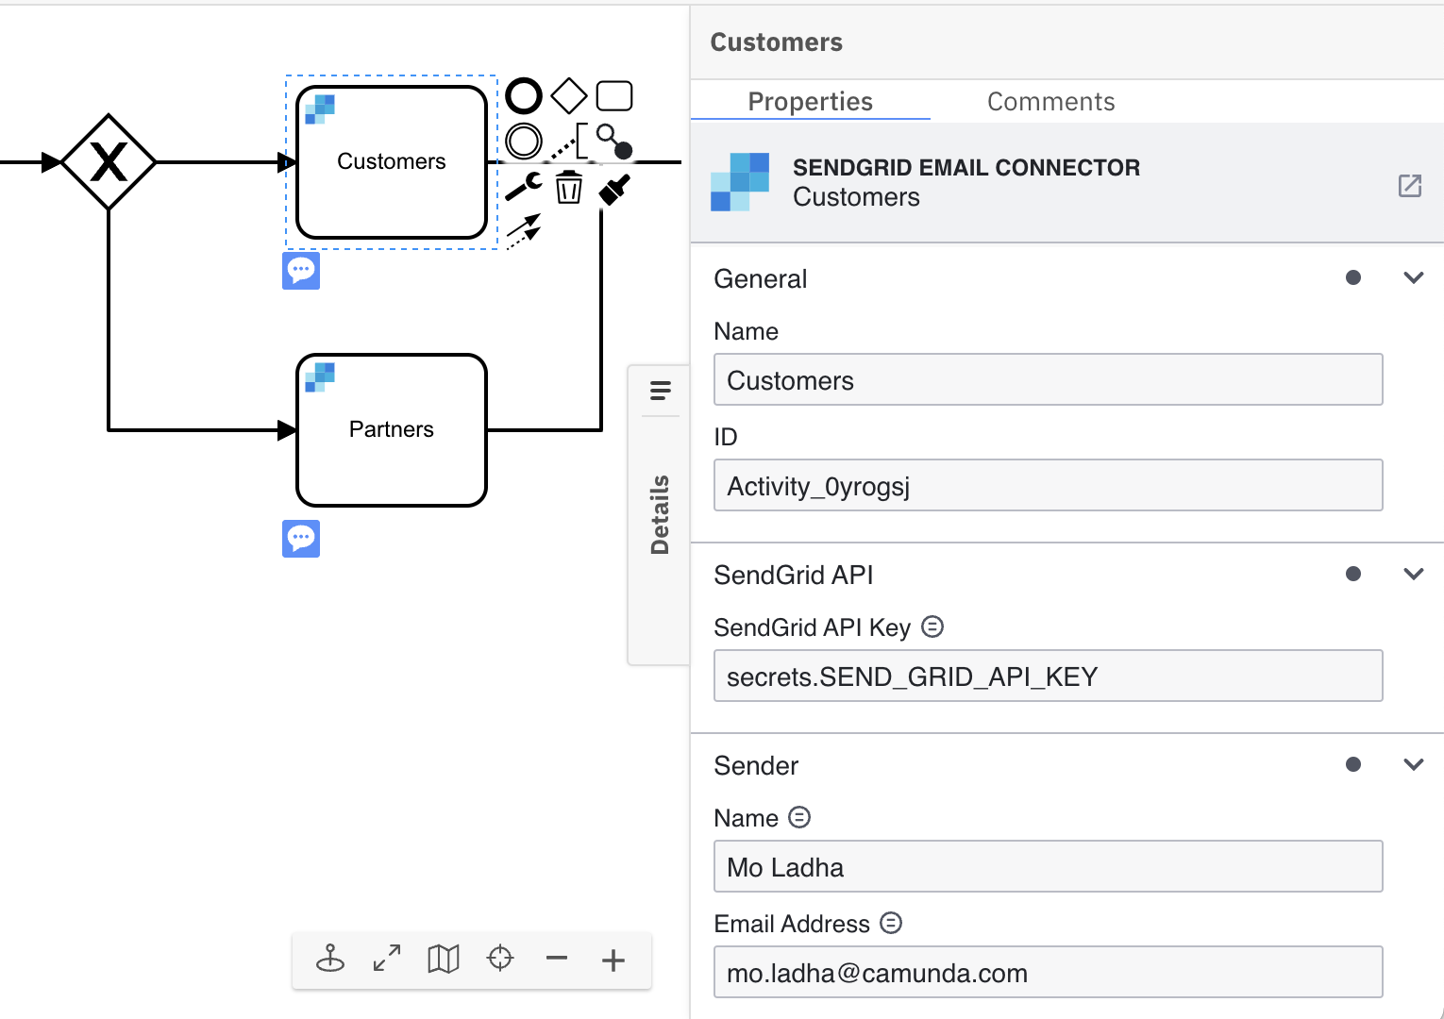
Create and Share Connectors
Create connectors in Camunda 8 and share them with your team
Connector Templates
Use the template creator to design the attributes and parameters required for your connector (and job worker) to talk to an external application
Share with your team & org
Share your connector templates with your project team and your organization in the web modeler, using the permissions you already have set up
Access in the Modeler
Easily find and use your connector in the modeling experience context pad
Dynamic Templates
Dynamic element templates make it easier for you to define a single template that covers multiple use cases and is easy to use.
===

Slide 44






Connectors
An outbound connector lets the Process invoke some outside system to do something
An inbound connector means the process can be triggered by some outside system
Discover & Reuse Connectors: Out of the box or built via new Integration Framework
Product Documentation: https://docs.camunda.io/docs/components/modeler/web-modeler/connectors/
Notes:
An outbound connector lets the Process invoke some outside system to do something (e.g., create a new opportunity in Salesforce). in BPMN, this would typically mean a Service Task, though it could also happen via a Message Throw Event.
An inbound connector means the process can be triggered by some outside system (e.g., Salesforce tells us that an opportunity was created). In BPMN, this would typically mean a Message Catch Event, though it could also happen via a Receive Task.
A big benefit of connectors is their reusability and ease of use.
We plan to make some connectors available out of the box with Camunda, but also are designing an integration framework that will allow you to create and provision your own connectors
In the future, we will enable you to discover existing connectors or publish your own through a marketplace
[Partners may also be interested in bringing their own connectors]

Slide 45
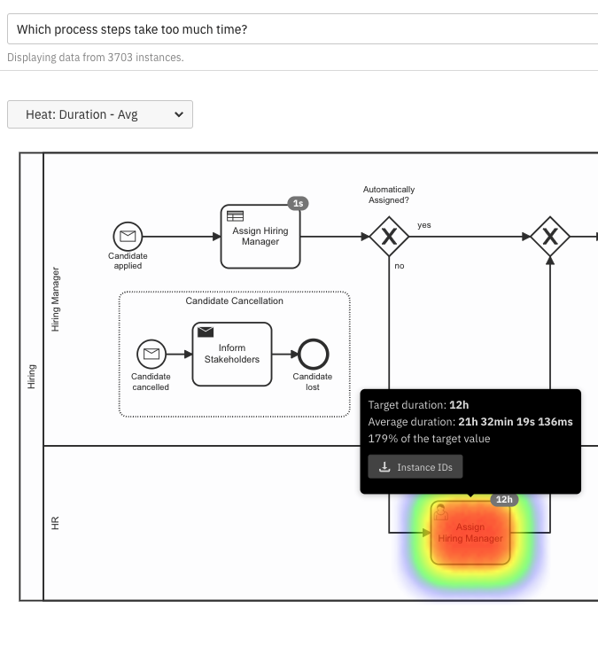
Enable Analytics and Dashboards
Optimize for Continuous Process Improvement
Immediate Insights
Generate actionable insights from your process data within minutes of getting started with Optimize
Passive Monitoring
Set it and forget it.
Optimize tells you when something important happens
Process Intel
Receive actionable recommendations that help you achieve your goals
Integrated Experience
Experience a single, coherent interface that takes advantage of the upstream Camunda applications
Product Documentation: https://docs.camunda.io/docs/components/optimize/userguide/collections-dashboards-reports/
Notes:
MAIN TAKEAWAYS
FASTER: Streamlined UX for easy onboarding and getting things done with less time logged in
EASIER: Notifications and telling you when something interesting happens with one of your processes
SMARTER: Smart analytics to pinpoint what’s “interesting” without you spending time analyzing and configuring

Slide 46
Leverage for Microservices Orchestration
Zeebe Cluster
Broker
Microservices / Apps
gRPC Gateway
Broker
Zeebe Client
Broker
Option 1: Embed Zeebe Client directly into Microservice
Product Documentation: https://docs.camunda.io/docs/components/zeebe/zeebe-overview/
List of available clients

Slide 47
Leverage for Microservices Orchestration
Zeebe Cluster
Http Microservice / App
Broker
Broker
Http Microservice / App
Broker
Http Connector
gRPC Gateway
Broker
gRPC Gateway
Http Microservice / App
Broker
Broker
Option 2: Use Generic Connector (HTTP, AWS Lambda, …)
Product Documentation: https://docs.camunda.io/docs/components/zeebe/zeebe-overview/
Example on Github

Slide 48
Leverage for Microservices Orchestration
Zeebe Cluster
Microservice / App
Microservice / App
Broker
Event Bus / Messaging System
(Kafka, RabbitMQ, ..)
gRPC Gateway
Broker
Pub / Sub
Broker
Microservice / App
Option 3: Use Zeebe as State Machine in Event Driven Microservices Architecture
Product Documentation: https://docs.camunda.io/docs/components/zeebe/technical-concepts/internal-processing/
Read more in this Blogpost

Slide 49


Use for Massive Scale Applications
Workflow Clients
Zeebe Cluster
Automation Apps
Microservices / Apps
Operate
Broker
Broker
Broker
Streaming Exporter
gRPC Gateway
Broker
Tasklist
gRPC Gateway
Event Bus / Messaging System
Broker
Broker
Connector (Http, …)
Optimize
Kubernetes
Product Documentation: https://docs.camunda.io/docs/components/zeebe/technical-concepts/architecture/
Notes:
Here is a picture showing a Zeebe Camunda Platform Cluster in more detail. On the left, you’ll see the different kinds of workflow client connections you can establish through a secure gRPC connection.
On the right, you’ll see that our streaming exporter hands data over real time to Elasticsearch, which acts as a data source for our other tools like Operate and Tasklist. More on those shortly.
Everything runs on Kubernetes which is great for decoupling and high availability
------------------------------------------------------------
Provides cloud-native building blocks that are decoupled and can be scaled individually.
gRPC <-> Multiple clients …
Mention different exporters
Zeebe implements the Gossip protocol to know which brokers are currently part of the cluster. The cluster is bootstrapped using a set of well-known bootstrap brokers, to which the others can connect. To achieve this, each broker must have at least one bootstrap broker as its initial contact point in their configuration. When a broker is connected to the cluster for the first time, it fetches the topology from the initial contact points and starts gossiping with the other brokers. Brokers keep cluster topology locally across restarts

Slide 50
Use for Massive Scale Applications
Client
1
Zeebe Partition (Leader)
Zeebe Partition (Follower)
2
Zeebe Partition (Follower)
Zeebe Partition (Follower)
3
Stream Processor
4
Local
State
5
1
Send & Append Command
2
Replicate & Commit Command
3
Validate & Process Command
4
Apply to State & Write Event
5
Send Response
Product Documentation: https://docs.camunda.io/docs/components/zeebe/technical-concepts/clustering/
Notes:
—-------------------------------------------------------------------------------------------------------------------------TALK TRACK—------------------------------------------------------
Let’s say we have an incoming client request to start a process instance
That request is first written to an append only log stream on the leader Zeebe partition, which is essentially a log file on disk in binary format
Once this write has finished, the request is spread among other follower brokers/partitions to replicate data and assure persistence in the case of node failure
Zeebe now begins processing this ‘process start’ event
Zeebe is implemented as a set of stream processors
Those processors emit NEW events on what has happened with the process (i.e. these new events signal that a process has indeed started)
this information also replicates to follower nodes, and only then after is the ‘local state’ updated
For those who are unfamiliar with ‘local state’, it’s a materialized view of all observed events
Camunda Cloud utilizes RocksDB for this, a persistent key-value store technology created by Facebook
After the local state has been updated and persistence has been assured, the engine signals back to the client that the process instance has started
the fact that Zeebe interprets process automation as event stream processing lends itself nicely to modern CPU and memory architectures, and also storage
—-------------------------------------------------------------------------------------------------------------------------EXISTING NOTES—------------------------------------------------------
For fault tolerance, data in a partition is replicated from the leader of the partition to its followers. Followers are other Zeebe broker nodes that maintain a copy of the partition without performing event processing.
Before a new record on a partition can be processed, it must be replicated to a quorum (typically majority) of followers. This procedure is called commit. Committing ensures a record is durable even in case of complete data loss on an individual broker. The exact semantics of committing are defined by the raft protocol.
Every state change in the process engine is called an event. Zeebe publishes every event as a record on the stream. State changes can be requested by submitting a command. A Zeebe broker receives commands from two sources:
Clients send commands remotely. Examples: Deploying processes, starting process instances, creating and completing jobs, etc. (1)
The broker itself generates commands. For example, locking a job for exclusive processing by a worker. (4)
Once received, a command is published as a record on the addressed stream.
A stream processor reads the record stream sequentially and interprets the commands with respect to the addressed entity's lifecycle. More specifically, a stream processor repeatedly performs the following steps:
Consume the next command from the stream (3).
Determine whether the command is applicable based on the state lifecycle and the entity's current state. If the command is not applicable, reject it. If the command is applicable,
apply it to the state machine.(4)
Publish an event reporting the entity's new state.(4)
If it was sent by a client, send a reply/response (can be success or error) (5).
---
Back-pressure: If the broker keeps accepting new requests from the client, the back log increases and the processing latency can grow beyond an acceptable time. To avoid such problems, Zeebe employs a back-pressure mechanism. When the broker receives more requests than it can process with an acceptable latency, it rejects some requests. The clients can retry them with an appropriate retry strategy. If the rejection rate is high, it indicates that the broker is constantly under high load. In that case, it is recommended to reduce the request rate.
As per: https://docs.camunda.io/docs/components/zeebe/technical-concepts/exporters/
Once data is not needed by Zeebe anymore, it queries its exporters to know if it can be safely deleted, and if so, permanently erases it, thereby reducing disk usage.

Slide 51
Use for Massive Scale Applications:
Partitions (Shards) and Replication enabling failover by electing a new leader
Node 0:
Partition 0 F
Partition 3 F
Partition 4 L
Node 1:
Partition 0 L
Partition 1 F
Partition 4 F
Example:
5 nodes
5 partitions
replication factor 3
L = Leader
F = Follower
Node 4:
Partition 2 F
Partition 3 L Partition 4 F
Node 2:
Partition 0 L
Partition 1 L
Partition 2 F
Node 3:
Partition 1 F
Partition 2 L
Partition 3 F
Notes:
I mentioned leader and follower partitions on the last slide we discussed
This diagram provides a visual representation of them
Partitions (shards)
chunks of data
a persistent stream of process-related events
When starting a process instance, the GRPC gateway will decide which partition to start the process on, and the instance will never leave that partition
Not every broker needs to have all the data; a limited number of replicas exist for each partition
Scalability is easily attainable because of this setup
This particular example
shows 5 brokers/nodes, 5 partitions, with a replication factor of 3
A partition uses roughly 2 - 2.5 vCPUs
due to the nature of stream processing, there is an upward bound of how many vCPUs can be tied to a partition
More partitions allow for more CPU resources and the partitions decide how these resources are used
You can create clusters of arbitrary size and resources
Leader and follower
Fault tolerance
For partition 0, Node 1 is the leader, while nodes 2 and 0 are followers
Only Node 1 (Leader) is actively processing the BPMN process instances of this partition
other nodes are just following along / storing events on disk / building local state (Rocks DB) in case of any outage / need for another node to take over processing (Show failover / new leader slide)
Let’s say we need to update Node 1, we would take it offline and the remaining follower nodes for partition 0 would automatically decide on who the new leader is. Processing would continue from there, as the majority of nodes associated with partition 0 are still available (2 out of 3).
Once Node 1 is back up and running, it becomes the leader again

Slide 52
Use for Massive Scale Applications
Designed to accommodate massive scale transactional solution use cases
No relational database bottleneck
Linear performance scaling
Notes:
Unlike traditional process engines, Zeebe is designed to accommodate high-throughput use cases out of the box
Because Zeebe doesn’t have a relational database, it doesn’t have a performance bottleneck
So the number of process instances that Zeebe can execute per second scales linearly

Slide 53
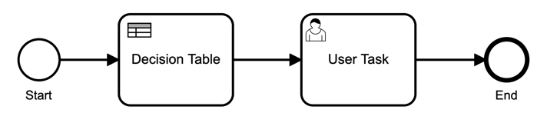
License Subscription Structure: Solution Use Case Scope(s)
Process Instances, Decision Instances, Task Users
1. Process Instances
What is the annual transaction volume of the process?
2. Decision Instances
How many automated decision tables will be used in the process?
3. Human Task Users
How many people will support manual tasks?
➕
➕
Per Solution Use Case Scope(s)
Solution License

Slide 54
License Subscription Structure: Definitions
Term | Definition | How to estimate
Process Instance (PI) | A usage metric. Technical execution of a BPMN Process Definition in the Camunda Workflow Engine, independent of current status (pending or completed). Additional process instances that are invoked via call activities are not counted separately. | What is the annual transaction volume of the process?
Decision Instance (DI) | A usage metric. Technical execution of a DMN Decision Model (e.g., a decision table) in the Camunda Decision Engine. Executions of single models as part of a composed decision model (e.g., in a DRD) will be counted separately. | Will you automate decisions using DMN as part of the workflow? How many decision tables will be in the process?
Task User (TU) | A usage metric. Distinct string that has been assigned to a User Task in the Camunda history. Each string will be counted once, i.e. if the same user has been assigned to more than one task during the contractual year, this will be only counted once. | How many people will directly interact with the process?
Advanced SLA | Product Support with a 24x7 availability and guaranteed 2 hour response times for severity 1 issues. | Need additional protection against production downtimes?
Support Contact | A named employee that is entitled to interact with the Camunda product support, open JIRA tickets. Support contact slots can be reassigned. | Need constantly more than 3 employees to directly interact with support?
Remote Consulting | A number of hours the customer can use with Camunda consultants per year on an as-needed basis to discuss best practices and get advice. | Need more than 10 hours per year?

